Slide 1


Lesson 4
Variables

Slide 2
Learning Objectives
By the end of this lesson, you will…
Understand how a sequence of code works
Understand how to use conditional statements to change the output of the code
Understand how to create and update variables
Understand that variables are useful tools to temporarily store data

Slide 3
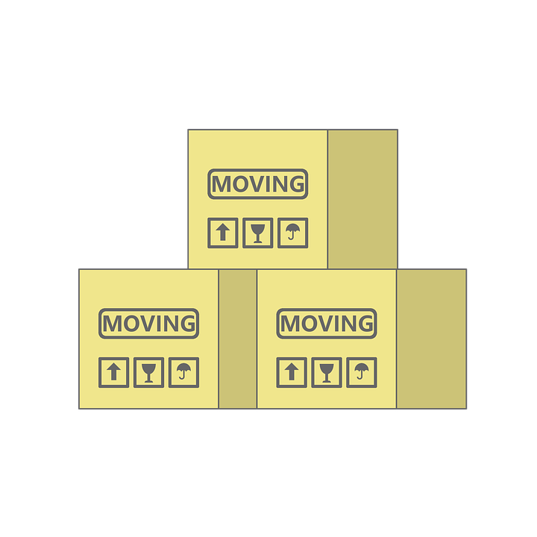
Lesson 4
What is a variable?
Have you ever tidied your room? Or moved home?
We get a box, write a name on it, then fill it up!
The box is just like a variable, it stores things temporarily.
If we use the name of the box, then the contents are displayed.

Slide 4
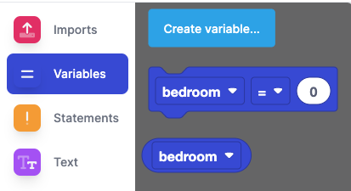
Lesson 4
How do variables work?
We first create a variable
Go to variables
Click on “Create Variable”
Call the variable “bedroom”
New blocks will appear

Slide 5
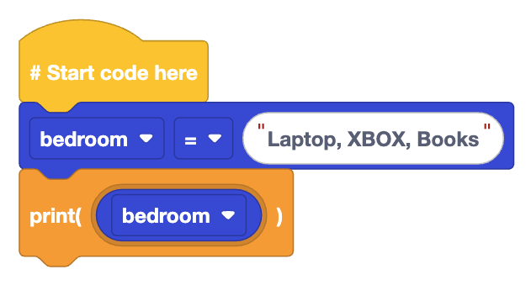

Lesson 4
How do variables work?
Here we fill the bedroom variable with items in our bedroom
Then we call the variable by name and print the contents
Variables can store any data type

Slide 6
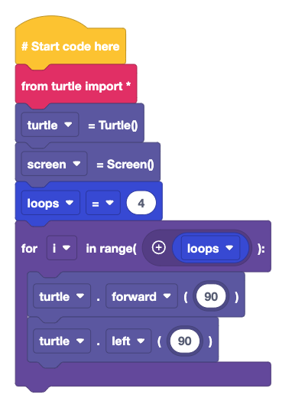
Lesson 4
Using a variable
Create a new variable called “Loops”
Set the value of loops to 4
Use a for loop and then get the loops block from Variables and place it in that block
What shape does this draw?

Slide 7
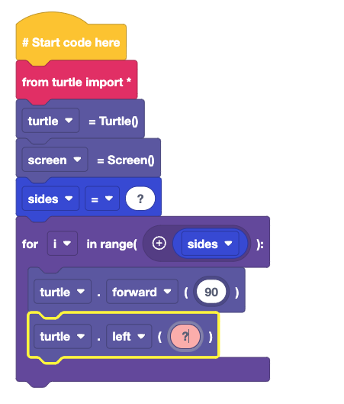
Lesson 4
Shape drawing app
We are going to create an app to draw shapes with Turtle
How do we ask the user for the number of sides?
Hint: User Input
How do we determine the turning angle?
Hint: The number of degrees in a circle divided by sides

Slide 8
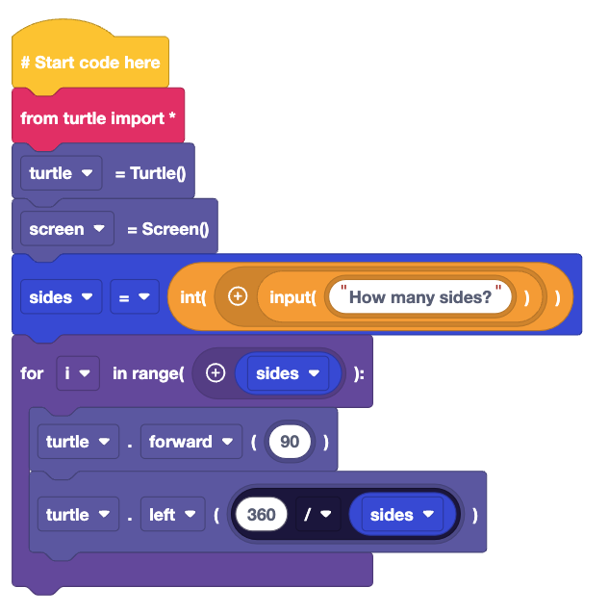
Lesson 4
Shape drawing app
The sides variable stores the answer to the question “How Many Sides”
Then we use the sides to control the number of loops
The turning angles is the answer to the calculation 360/sides

Slide 9
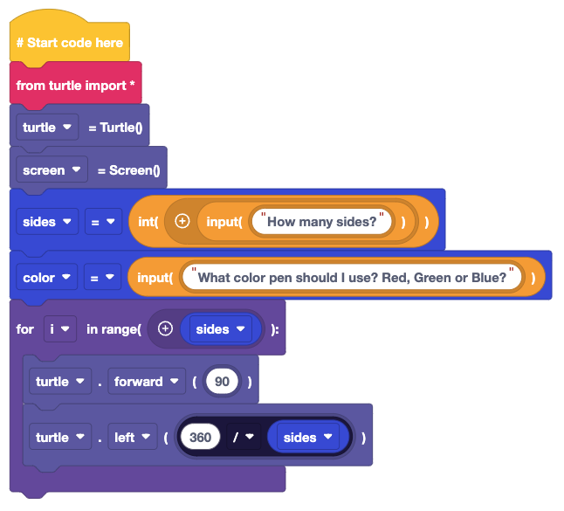
Lesson 4
Adding colour to the app
Add another variable called colour
Store the user input with the colour variable
The only colours should be red, green or blue
Insert the colour variable between the sides variable and the for loop.
Run the code
What happens?
Did you expect that to happen?

Slide 10
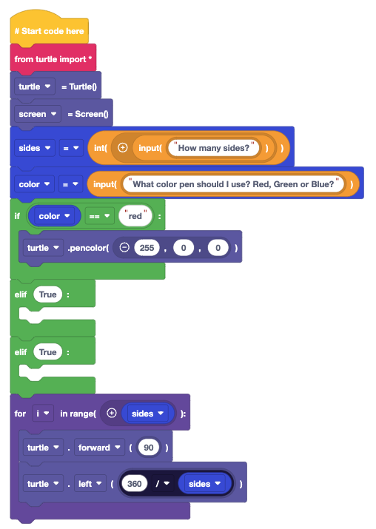
Lesson 4
Adding colour to the app
We have captured the users colour choice, but how do we use it?
We need to use conditional tests and logic to make this work
The green blocks are found in Logic
We’ve created the test for red, can you finish the code?
Red: 255,0,0
Green: 0,255,0
Blue: 0,0,255
Run the code, what happens?

Slide 11
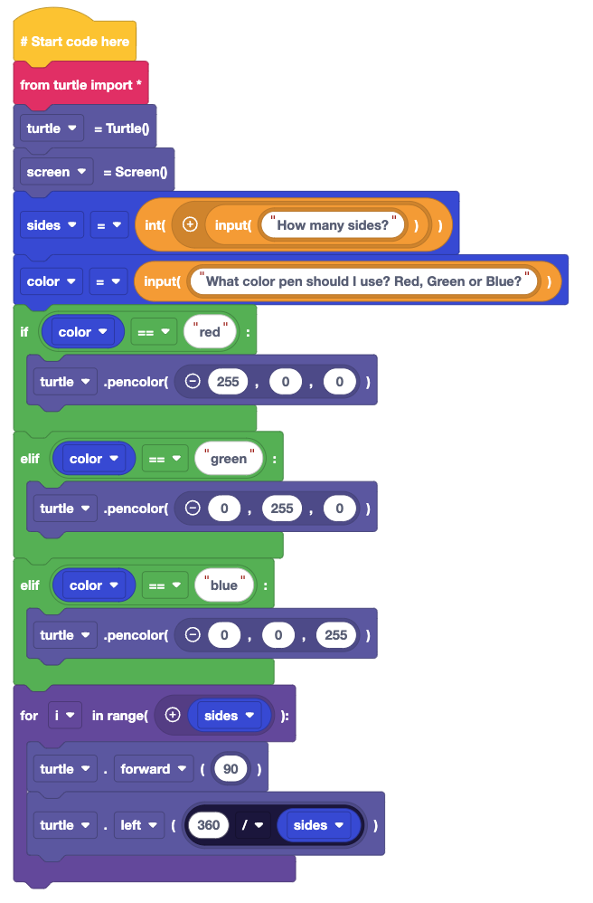
Lesson 4
Challenge Solution
Does your code look like this?
We’ve used variables to capture the user information
Conditional logic to compare the input with known colours
Drawn shapes using maths and loops

Slide 12
Plenary
What have we learnt?
How to create a variable
How to use a variable to control a loop
How to use conditional logic with a variable

Slide 13
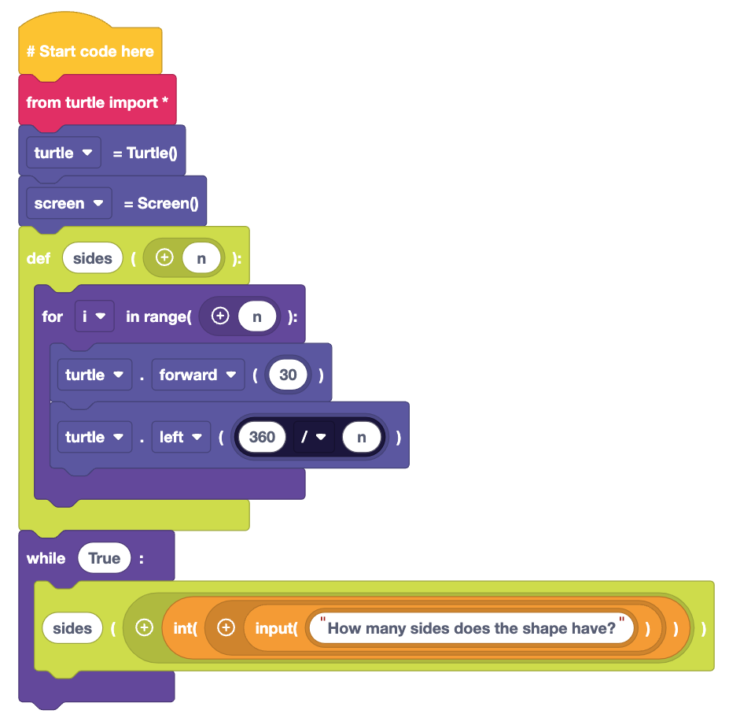
Plenary
Next Lesson
Next Lesson we will use EduBlocks to create functions that will draw patterns and shapes automatically

